Slide 1

Lecture № 11
General characteristics of the Bryophytes, Pteridophyta, Horsetails
al-Farabi Kazakh National University
Faculty Biology and Biotechnology
Discipline Botany

Slide 2
Content of a lesson
Main features of higher spore plants
Bryophytes (mosses, hornworts, and liverworts)
Lycopodium
Horsetails
Ferns
The uses of higher spore plants
Conclusion

Slide 3
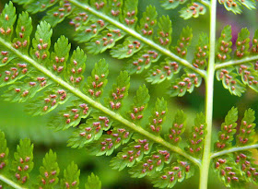
Questions
Which plants belongs to higher spore plants?
Where are these plants found?
What are the differences between higher spore plants and Gymnosperms?
What are the main features of Mosses (morphological and anatomical structure, classification, reproduction, examples)?
What are the main features of Equisetophyta (morphological and anatomical structure, reproduction, examples)?
What are the main features of Polypodiophyta (morphological and anatomical structure, reproduction, examples)?
What are the main features of Ferns (morphological and anatomical structure, reproduction, examples)?
The practical significance of higher spore plants ?

Slide 4
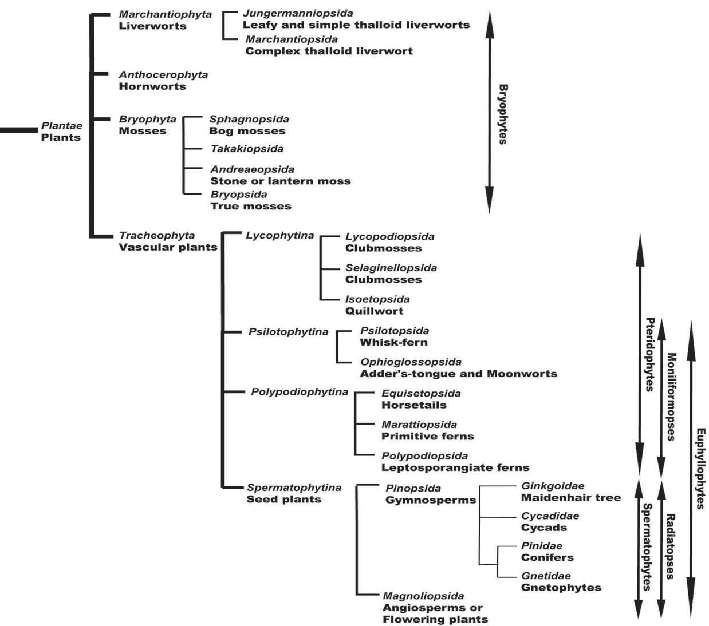
Kingdom Plantae or subkingdom
Embryobionta: PLANTS
Bryophytes and tracheophytes are monophyletic (one branch of the evolutionary tree of life) and collectively called embryophytes. As the name implies, there is an embryonic stage in these organisms as contrasted with their closest relative green algae.
A phylogenetic arrangement of living plants.

Slide 5
Another feature that distinguishes plants from almost all algae is the presence of complex reproductive organs, the archegonium, antheridium and sporangium. Other shared features of plants include the following: haplodiplobiontic life cycle and multicellular sporophytes; sporopollenin in the spore wall (also detected in some algae); cuticle (waxy outer layer of the epidermis).

Slide 6
Bryophytes (mosses, hornworts, and liverworts) can be found in all ecosystems of earth. The diversity increases at tropical and subtropical latitudes. Another term commonly used for this group is nonvascular plants. All embryophytes have a life cycle that involves an alternation between sporophyte and gametophyte generations.

Slide 7
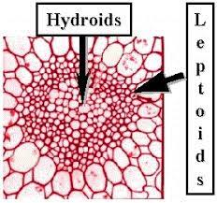
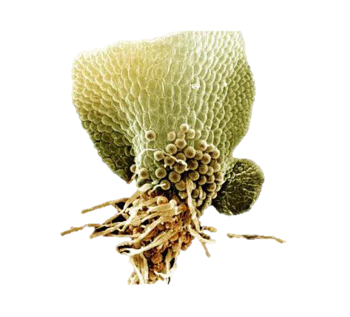
Most of Bryophytes have a limited ability to control their water content (poikilohydric);
Conductive tissues are absent;
Some species of mosses and liverworts have hydroids that are analogous to the tracheids and leptoid is a type of elongated food-conducting cell like phloem in the stems;
Bryophytes lack roots but have rhizoids, elongated cells that penetrate the soil. They differ from roots in their simplicity; they are mainly unicellular or, if multicellular, they are usually uniseriate.

Slide 8
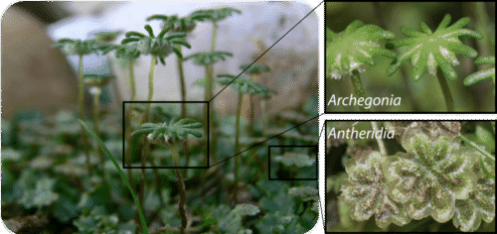
Life cycle of mosses is similar to the general life cycle of land plants. They begin with a gametophyte with an archegonia and antheridia.
Female gametangia (gamete “homes”) is called archegonium, the male gametangia—anteridium.
The archegonium produces oocyte which is fertilized by the anteridium’s spermatozoon in the process of oogamy.
The reproductive organs of Bryophytes like this liverwort are male antheridia and female archegonia.
Most of moss gametophytes have a shoot body that consists of a stem and leaves (but no roots) while others have a thallus body, which is a flat, leaf-like, and undifferentiated structure.

Slide 9
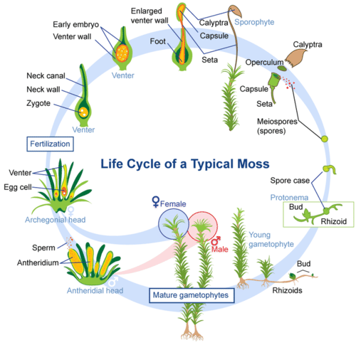
The life cycle of most mosses begins with the release of spores from a capsule, which opens when a small, lidlike structure, called the operculum, degenerates. A single spore germinates to form a branched, filamentous protonema, from which a leafy gametophyte develops.
The gametophyte bears organs for sexual reproduction. Sperm, which are released by the mature antheridium (the male reproductive organ), are attracted into the neck of an archegonium (the female reproductive organ). Here, one sperm fuses with the egg to produce the zygote.
After cell division, the zygote becomes the sporophyte, and, at the same time, the archegonium divides to form the protective calyptra. The sporophyte usually consists of a capsule and a seta. Asexual reproduction occurs within the capsule and the whole process may begin again.

Slide 10
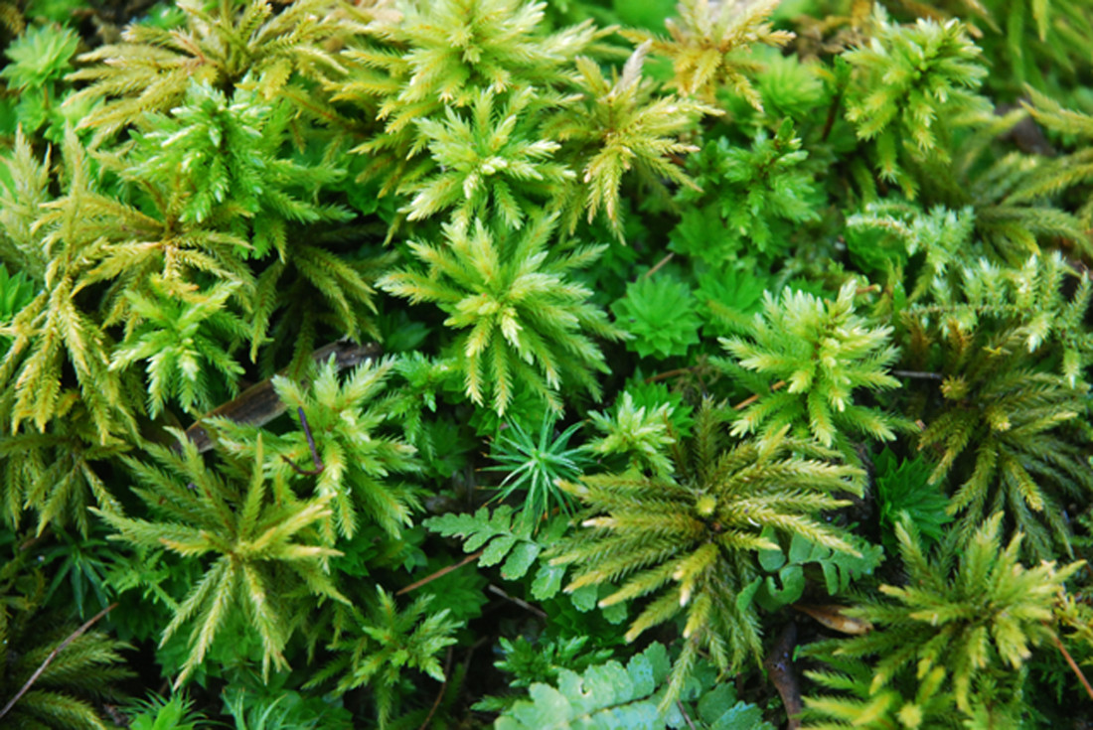
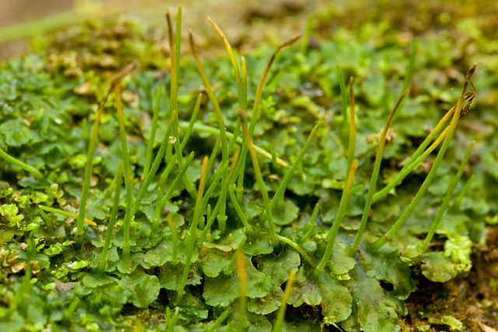
Classification of Bryophytes
Phylum Marchantiophyta – Liverworts (Hepaticophyta),
(approximately 6,000 species worldwide)
Phylum Bryophyta – Mosses (Bryophyta),
(approximately 12,800 species worldwide)
Phylum Anthocerotophyta – Hornworts (Anthocerophyta),
(approximately 150 species worldwide)

Slide 11
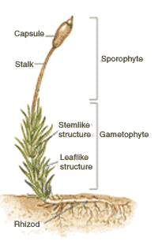
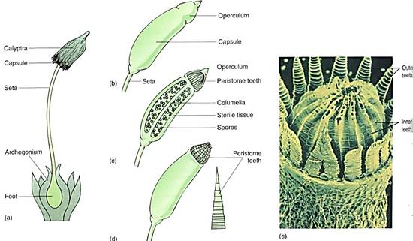
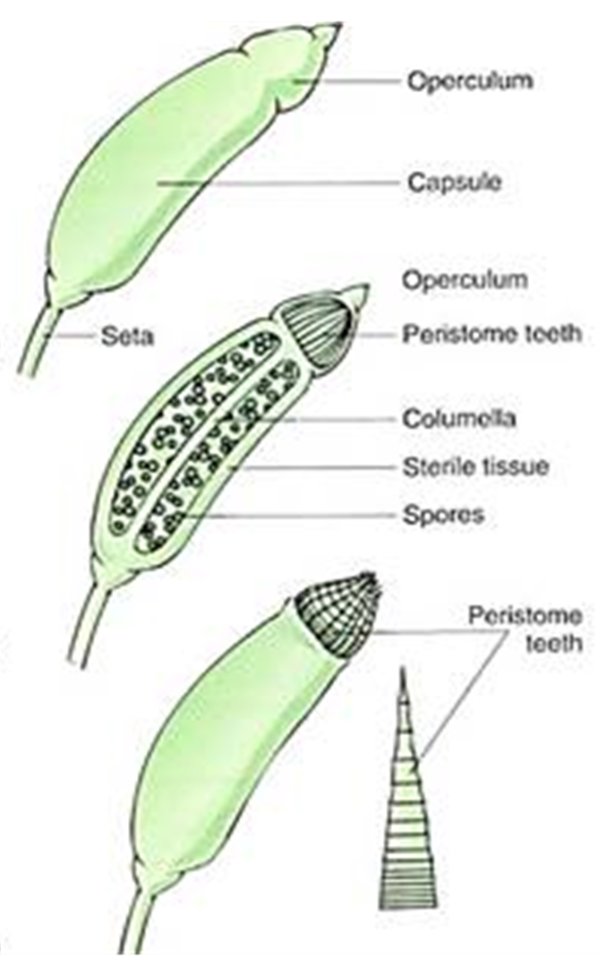
An operculum, at the apex of the sporangium, falls off to expose peristome teeth that aid in the dispersal of spores.
Peristome teeth arrangement and morphology aid in distinguishing certain taxonomic categories. Finally, stomata are typically present on the walls of the sporangium. Stomata aid in gas exchange and are also found on tracheophytes.
The seta supports and elevates the sporangium to aid in spore dispersal.
The calyptra, a protective tissue around the sporangium arising from the ventor of the archegonium, expands after seta elongation and falls off the sporangium when the sporangium is mature.
The structure of a typical moss plant

Slide 12
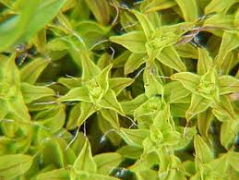
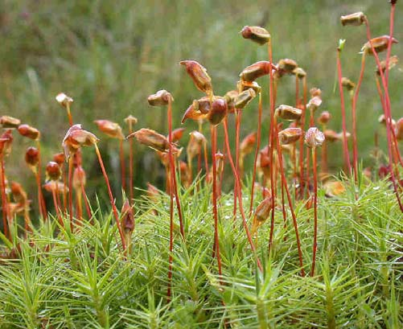
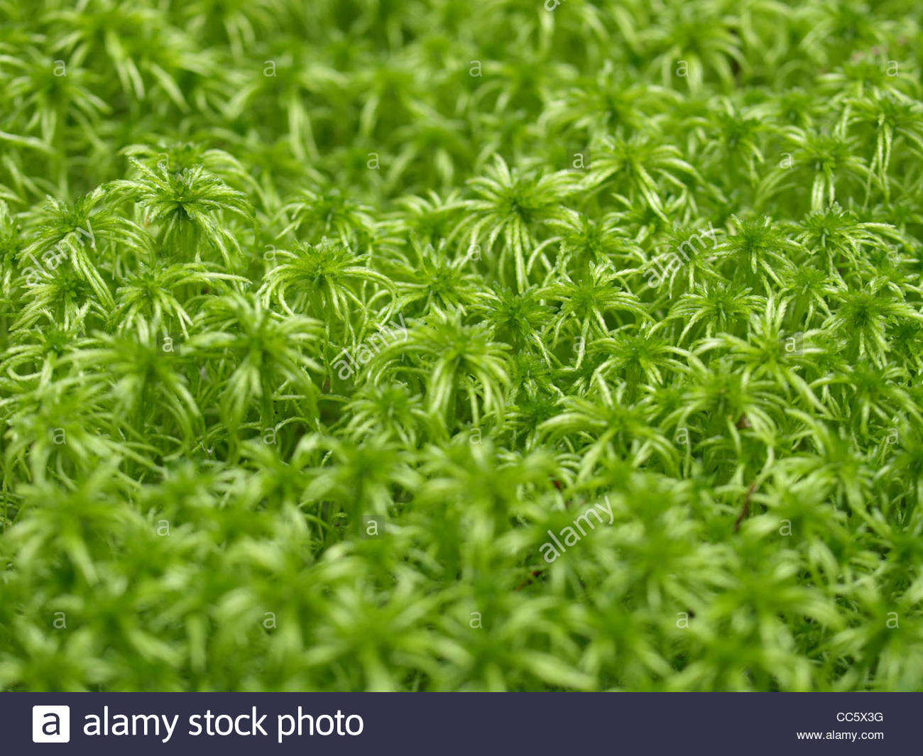
Bryopsida
Polytrichum
Sphagnum

Slide 13
Mosses Have Significant Economic and Ecological Value
Sphagnum, a large genus of peat mosses, is by far the most economically important bryophyte. Because of their special epidermal cells, Sphagnum mosses are frequently added to potting soil to increase its water-holding capacity. Tons of Sphagnum are harvested throughout the world and then sold in the nursery industry in many countries. During World War I, Sphagnum was used on a large scale as a wound dressing because its acidic sterile tissue acts as both an antiseptic and an absorbent.
In some cold-temperate areas, Sphagnum and other mosses accumulate as a thick, compacted, semi-decomposed layer atop the mineral soil. This deposit, called peat, can be cut out in blocks, dried, and burned as fuel for cooking and heating. On a much larger scale, the Rhode generating station in Ireland burns 2,000 metric tons of peat a day to produce electricity.

Slide 14
Pteridophyta: the ferns
Pteridophyta, ferns and allies, have approximately 12,000 species and six classes. They have a sporic life cycle with sporophyte predominance whereas their gametophytes are often reduced to prothallium, small hornwort-like plant. Another frequent variant is the underground, mycoparasitic gametophyte.

Slide 15
Pteridophyta (with one exception) have true roots.
Most of them have vascular tissues and are homoiohydric. This is why seed plants together with ferns have a name vascular plants. Pteridophyta sporophytes always start their life from an embryo located on the gametophyte. While Pteridophyta have true xylem and phloem, they do not have developed secondary thickening.

Slide 16
Diversity of Pteridophytes
Phylum of Lycopodiophyta consist of two separate class:-
1) Lycopodiopsida
2) Polypodiopsida
Class Lycopodiopsida
Order Lycopodiales
Family Lycopodiaceae
Genus Lycopodium
Order Selaginellales
Family Selaginellaceae
Genus Selaginella
Order Isoetales
Family Isoetaceae
Genus Isoetes

Slide 17
Class Lycopodiopsida, or lycophytes have at least four genera and more than 1,200 species.
-Lycophyte sporangia are associated with leaves and often form strobilus which is condensation of sporangia-bearing leaves (sporophylls when they are leaf-like or sporangiophores when they are divergent).
-Their spermatozoon usually has 2 flagella (like mosses) but are sometimes also multiflagellate (like spermatozoa of other ferns).
More basal lycophytes (clubmosses Huperzia and Lycopodium) have equal spores and underground gametophytes, whereas more advanced Selaginella (spikemoss) and Isoëtes (quillwort) are both heterosporous with reduced aboveground gametophytes.

Slide 18
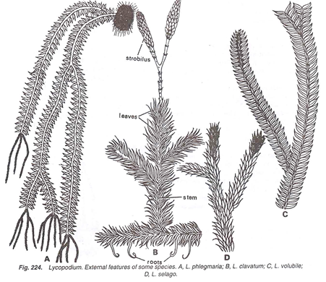
Stem is erect or pendant in sub-genus Urostachya, while it is prostrate with upright branches in sub­genus Rhopalostachya. The branching of the stem is partly monopodial and partly dichotomous. The stem is thickly covered with many leaves.
Leaves are eligulate, simple, small, sessile, usually lanceolate in outline with broad base. Each leaf contains a single unbranched midvein.
Roots are adventitious, dichotomously branched and small.
Lycopodium. External features of some species: A.- L. phlegmaria, B – L. clavatum, C – L. volubile, D – L. selago

Slide 19
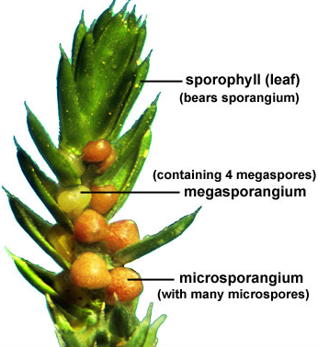
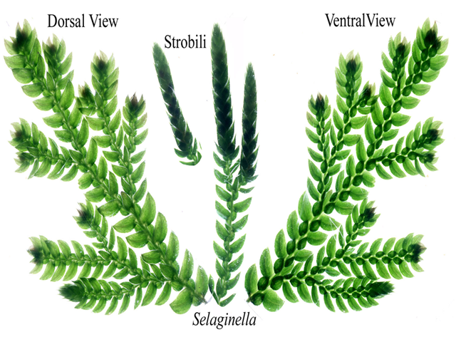
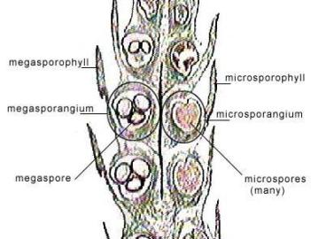
Also heterospory occurs in the Lycophyta, for example in Selaginella. Two types of sporangia develop on the sporophylls: macrosporangia (female sporangia) on the lower sporophylls and microsporangia (male sporangia) on the upper sporophylls. The sporangia are located in the so-called ligula, which are small lingular, chlorophyll-lacking scale at the upper side of the base of the sporophylls.
Selaginella: plant body, strobilus
Strobilus of Selaginella sp.

Slide 20
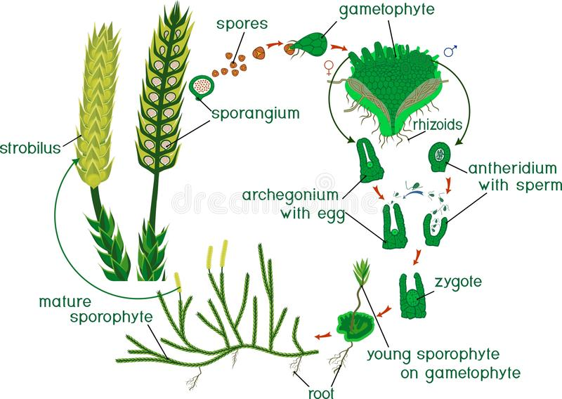
Sexual reproduction
Steps in Life cycle of Lycopodium
Lycopodium plant body is sporophyte (Diploid 2n)
Strobilus or cone is the spore bearing structure
In Strobilus diploid spore mother cells undergo meiosis forming haploid spores (1 n)
Spores germinate forming gametophyte or protallius (Monoecious: both antheridia and archegonia are present)
Antheridium produce sperms. Sperms are multiflagellate. Archegonium produce egg.
Fertilization is oogamous.
Zygote divides to form Embryonic sporophyte later form mature plant body (Diploid Lycopodium sporophyte)

Slide 21
Asexual reproduction
Lycopodium branch out and expand through rhizomes, which are actually branches that stretch out and creep along over or under the soil, which seek out new areas of the soil to root and live. Rhizomes form roots, called adventitious roots, which when they send vertical shoots above ground, are the asexually reproducing generations of the lycopodium. New shoots can be formed from rhizomes coming directly out of the sporophyte.

Slide 22
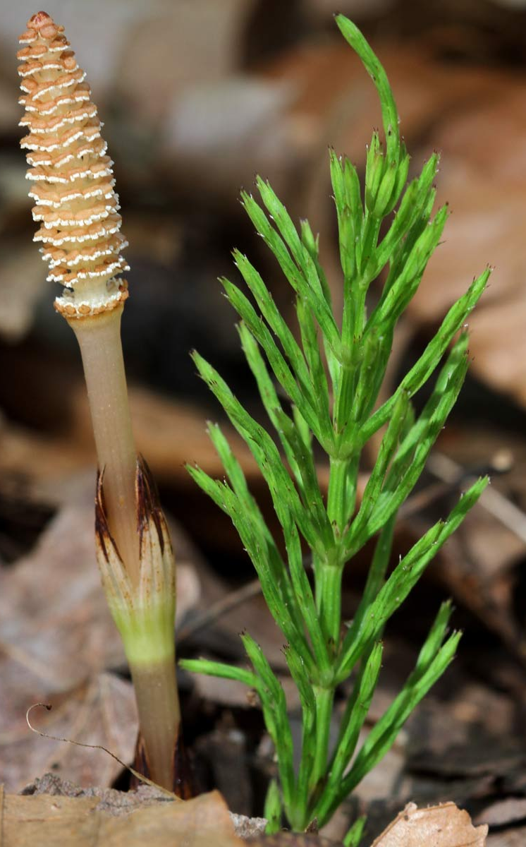
Phylum Equisetophyta
Class Equisetopsida
Order Equisetales
Family Equisetaceae – Horsetail family
Genus Equisetum
-Class Equisetopsida (horsetails) is a small group with one genus, Equisetum, and has about 30 different herbaceous species that typically live in moist habitats.
-The leaves of these plants are reduced into scales, and the stems are segmented and also photosynthetic; there is also an underground rhizome.
-The stem epidermis contains silica which makes it have an abrasive surface. The stem has multiple canals, this is somehow similar to stems of grasses.
Equisetum
Gametophytes are typically minute and dioecious, but the plants themselves are homosporous: smaller suppressed gametophytes develop only antheridia while larger gametophytes develop only archegonia.

Slide 23
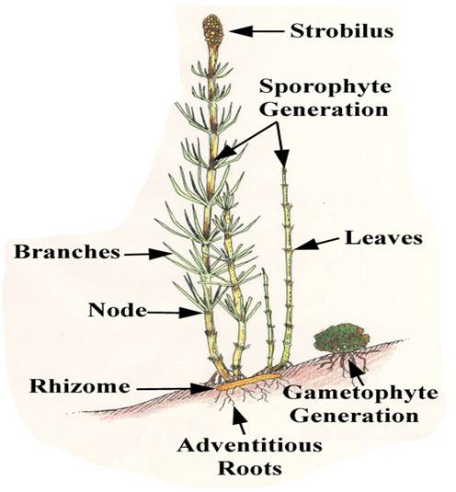
Genus Equisetum
The sporophytic plant body of Equisetum is differentiated into stem, roots and leaves.
The stem of Equisetum has two parts: perennial, underground, much-branched rhizome and an erect, usually annual aerial shoot. The branching is monopodial, shoots are differentiated into nodes and internodes.
Some shoots are profusely branched, green (chlorophyllous) and purely vegetative. The others are fertile, unbranched, brownish in colour (achlorophyllous) and have terminal strobili. The underground rhizome and the aerial axis appear to be articulated or jointed due to the presence of distinct nodes and internodes. Externally, the internodes have longitudinal ridges and furrows and, internally, they are hollow, tube-like structures.
Equisetum plantbody

Slide 24
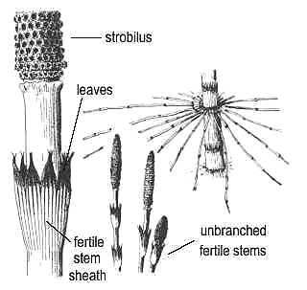
Leaves:
The leaves of Equisetum are small, simple, scale-like and isophyllous; they are attached at each node, united at least for a part of the length and thus form a sheath around the stem (verticil). The sheath has free and pointed teeth-like tips. The number of leaves at a node corresponds to the number of ridges on the internode below. The leaves do not perform any photosynthetic function and their main function is to provide protection to young buds at the node.

Slide 25
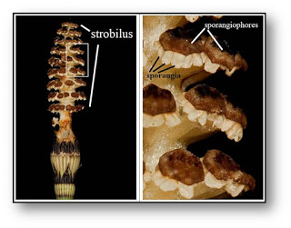
Spores are produced within the sporangia. The sporangia are borne on the sporangiophores which are aggregated into a compact structure termed strobilus or cone or sporangiferous spike.
The strobilus is composed of an axis with whorls of sporangiophores.
Strobilus of Equisetum
At maturity, the strobilar axis elongates, as a result the sporangiophores become separated and exposed. Then the sporangium splits open by a longitudinal line due to the differential hygroscopic response of the wall cells.
Sporangiophores with sporangia

Slide 26
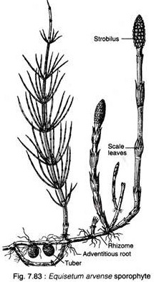
Reproduction in Equisetum:
Equisetum reproduces vegetatively and by means of spores.
Vegetative Reproduction:
The subterranean rhizomes of some species (e.g., E. telmateia, E. arvense) form tubers which, on separation from the parent plant, germinate to produce new sporophytic plants. The tubers develop due to irregular growth of some buds at the nodes of the rhizomes.

Slide 27
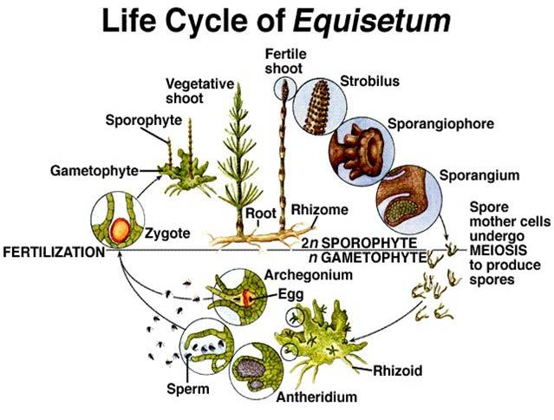
Spore cases form small cones on the stems of the plant. The spores themselves are dispersed by the wind. If they land in a wet or damp place, they can germinate and grow into tiny plants called gametophytes.
The gametophyte grows two different structures, one holding female gametes in tiny cups and the other holding male gametes equipped with tails to aid in movement. This phase of the
horsetail's life cycle, known as gametophyte generation, exists to ensure genetic diversity.
Horsetails rely on rain for fertilization. The arrival of rain releases the male gametes, which then swim to the cups holding the female cells. The embryos grow to form the stem-like structure that characterizes the mature horsetail.

Slide 28
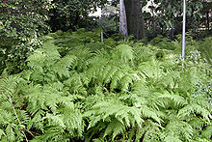
Phylum Polypodiophyta
Class Polypodiopsida
Order Polypodiales
Family Polypodiaceae
Genus Polypodium
Fern, (class Polypodiopsida), class of nonflowering vascular plants that possess true roots, stems, and complex leaves and that reproduce by spores. Geographically, ferns are most abundant in the tropics.
Arctic and Antarctic regions possess few species.
As a group of plants, ferns are not of great economic value. Many different species have been used as a minor food source and for medicine in various parts of the world.

Slide 29
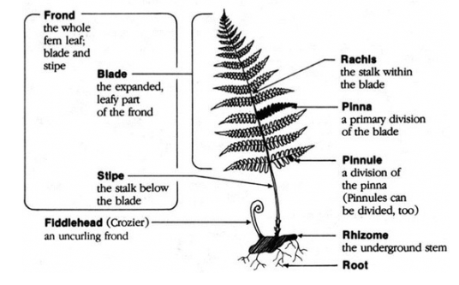

Slide 30
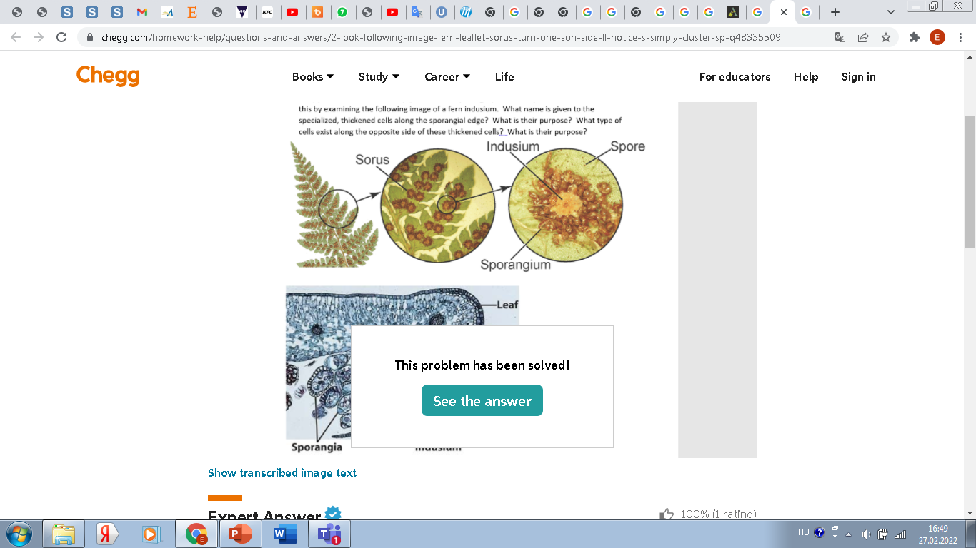
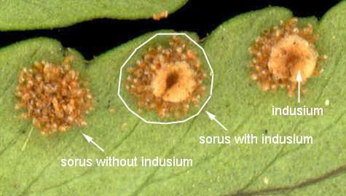

A flap of tissue that protects the sorus in some ferns. When spores are mature and ready for release, the indusia usually shrivel or bend backwards to expose the sporangia.

Slide 31
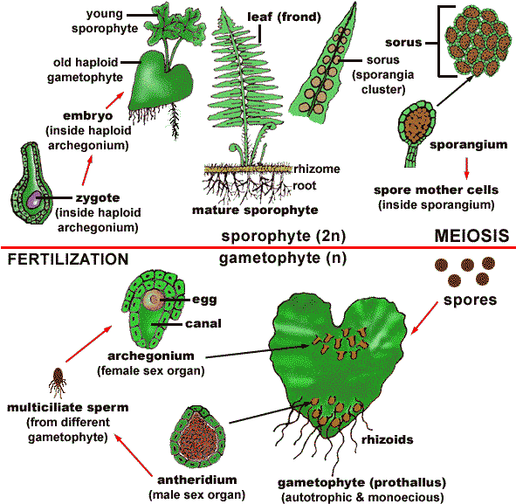
LIFE CYCLE OF FERN

Slide 32
Conclusion
Plants without seeds, such as ferns, horstails, mosses, develop from spores. Spores are produced within sporangia and are released into the environment.
These plants world wide distributed, but commonly in moist habitat, because the water is necessary for their life cycle
The higher spore plans have a significant practical value (in medicine, food industry, landscape)

Slide 33
Main terms
Archegonia
Antheridia
Sporangium
Air chambers
Peristome teeth
Operculum
Macrosporangia
Microsporangia
Sorus
Indusium

Slide 34
Thank you for attention!

